Slide 1
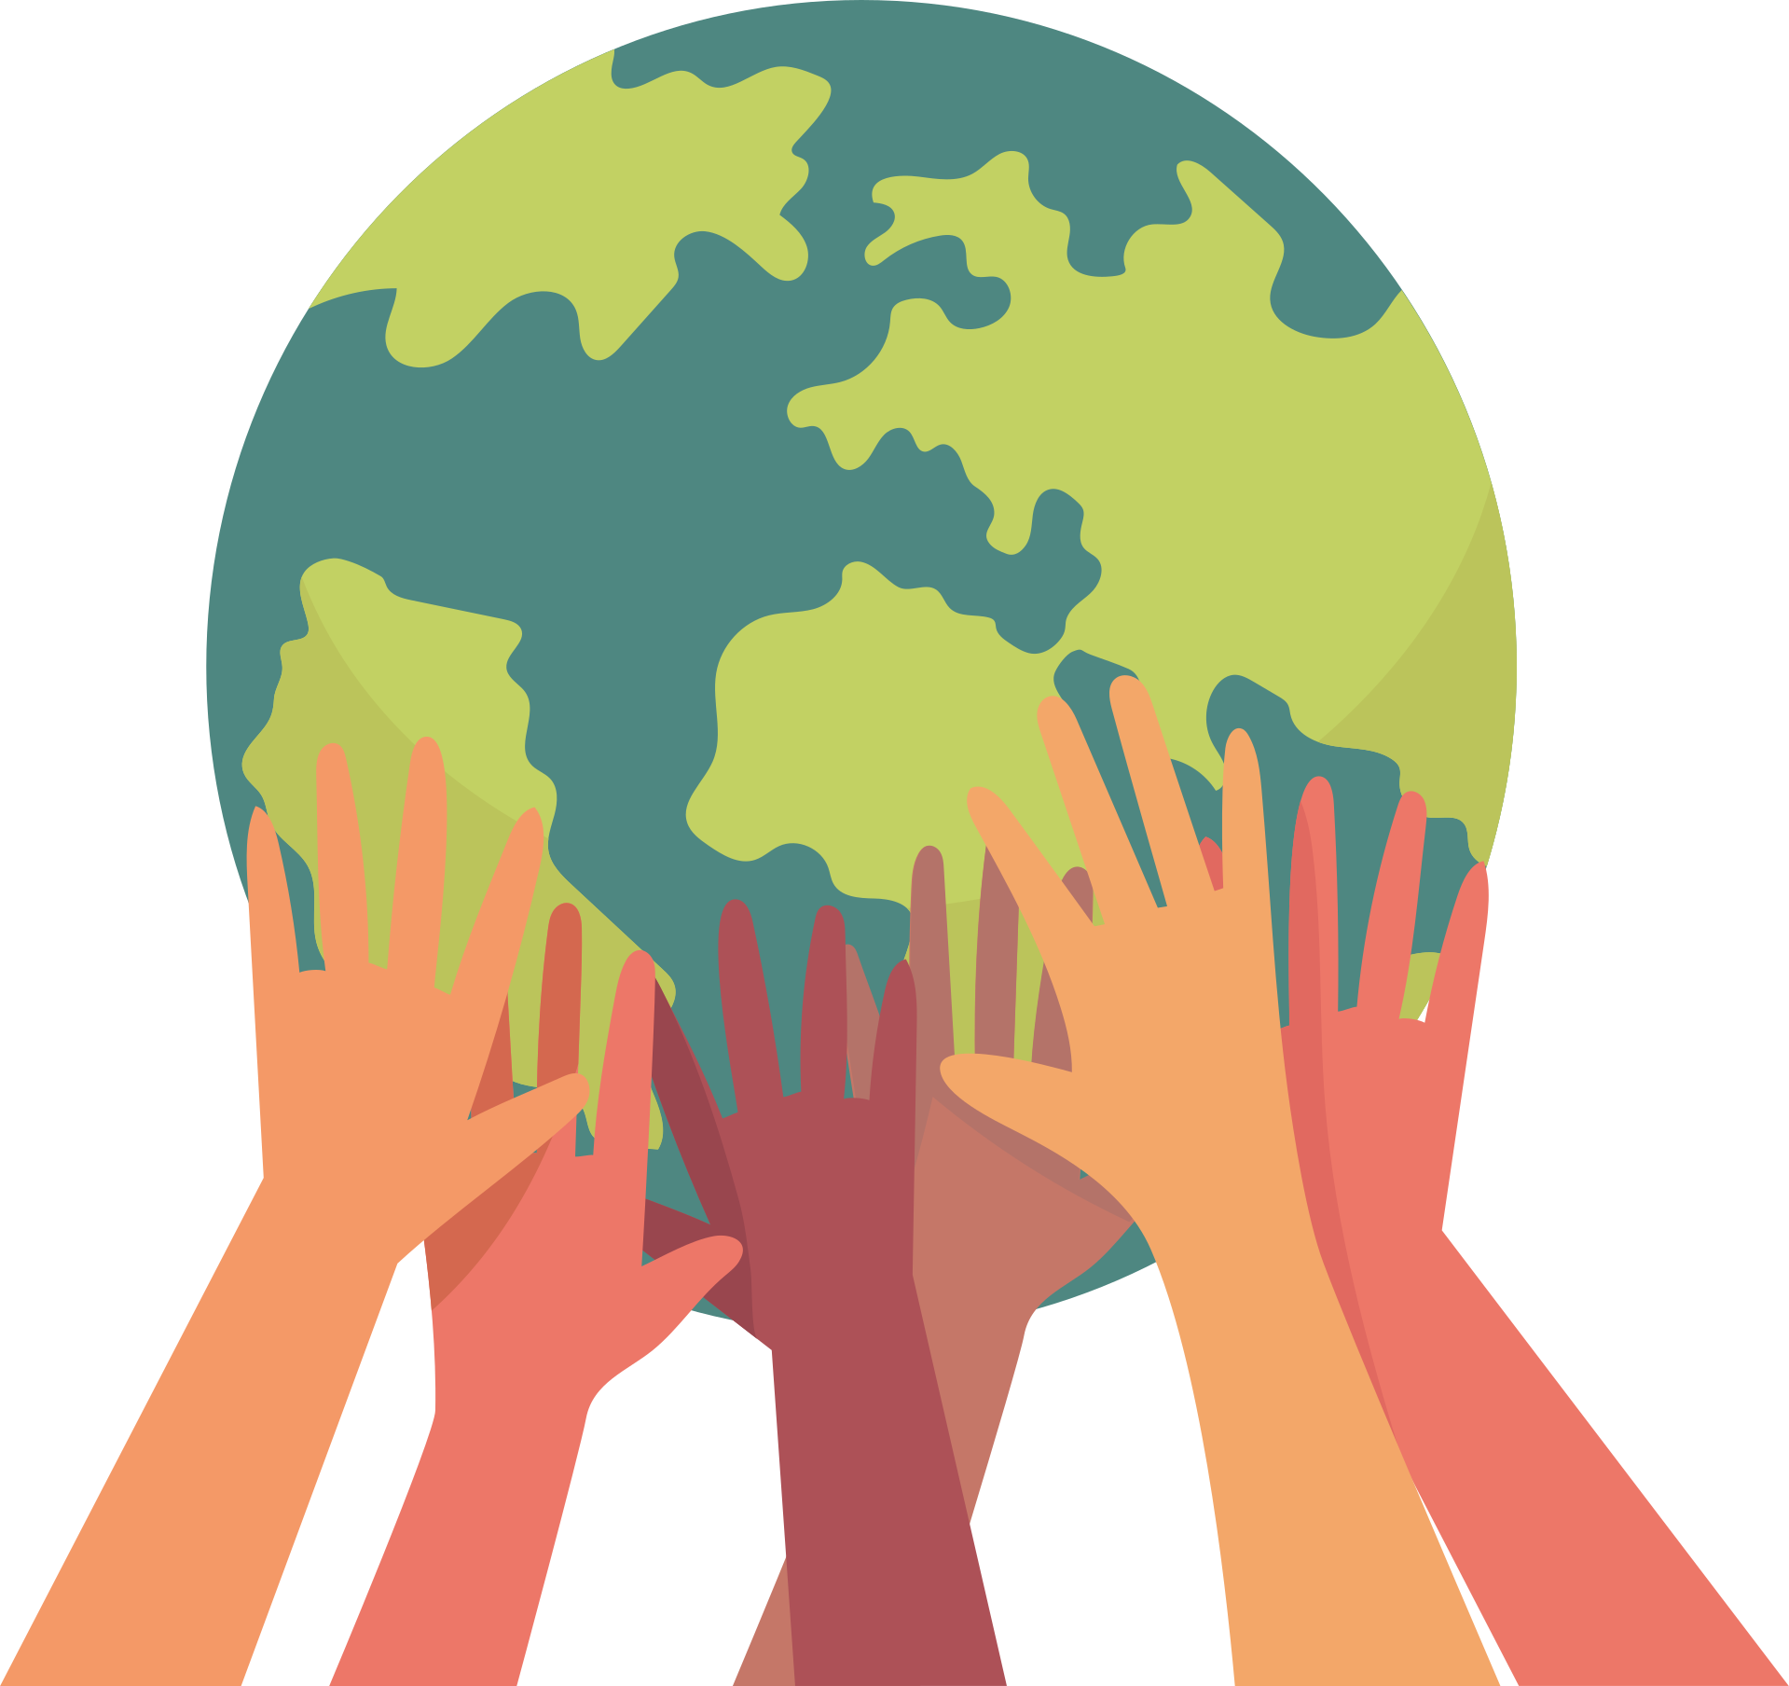
ENVIRONMENTAL CITIZENSHIP
BY
TEAM POLAND

Slide 2
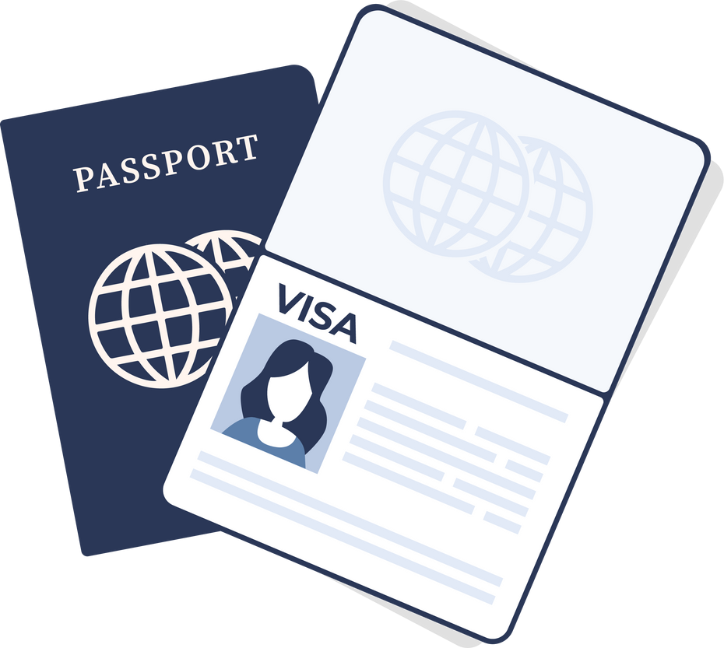
PAGE
.01
ENVIRONMENTAL CITIZENSHIP
entails the right to participate in environmental policy making, choose sustainable personal actions, obey just environmental law, and promote sustainable arrangements
ENVIRONMENTAL CITIZENSHIP

Slide 3
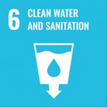
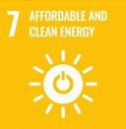
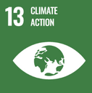
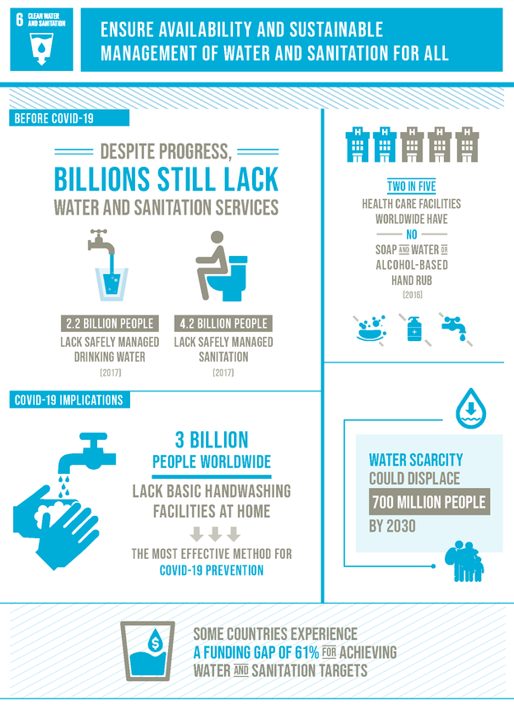
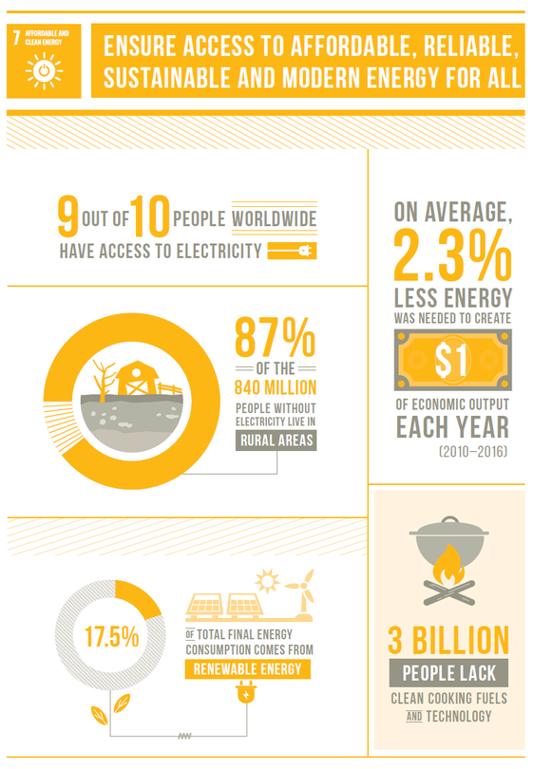
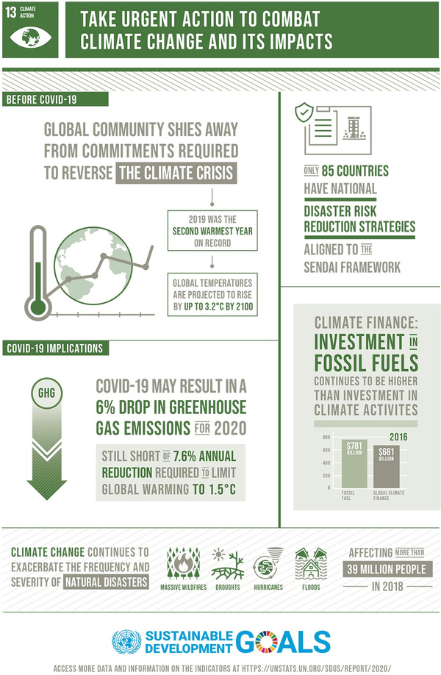
PAGE
.01
.02
.03
.02
Ensure availability and sustainable management of water and sanitation for all.
Ensure access to affordable, reliable, sustainable and modern energy for all.
Take urgent action to combat climate change and its impacts.
ENVIRONMENTAL CITIZENSHIP

Slide 4
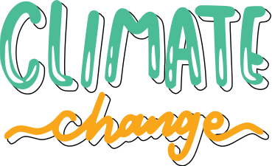
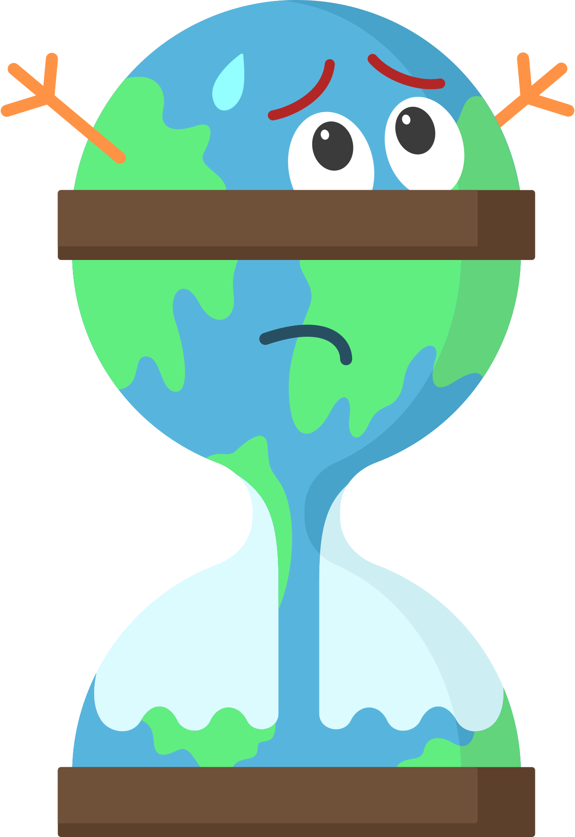
PAGE
.03
IPCC REPORT
The IPCC prepares comprehensive Assessment Reports about the state of scientific, technical and socio-economic knowledge on climate change, its impacts and future risks, and options for reducing the rate at which climate change is taking place.
ENVIRONMENTAL CITIZENSHIP
The Intergovernmental Panel on Climate Change (IPCC) is the United Nations body for assessing the science related to climate change.

Slide 5
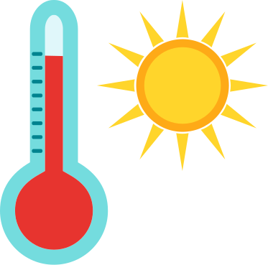
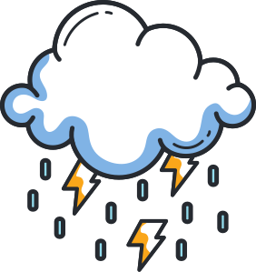
PAGE
CONSEQUENCES OF GLOBAL WARMING
.04
.01
.02
.03
Drought
Storms and flood
Heat waves
.04
.05
.06
Rising sea level
Melting glaciers
Warming oceans
ENVIRONMENTAL CITIZENSHIP

Slide 6
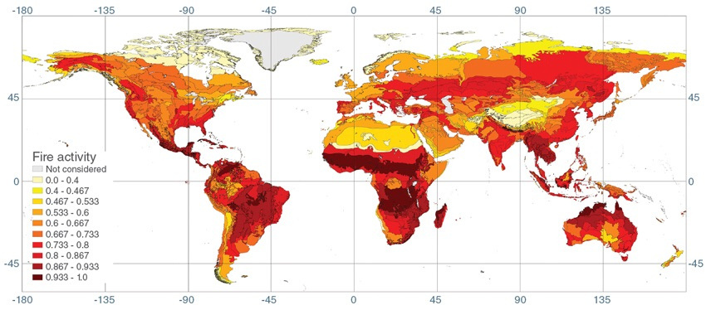
PAGE
WILDFIRES
.05
On Earth, something is always burning. Wildfires are started by lightning or accidentally by people.
Beside that people use controlled fires to manage farmland and pasture and clear natural vegetation for farmland.
Some of the global patterns that appear in the fire maps over time are the result of natural cycles of rainfall and dryness.
ENVIRONMENTAL CITIZENSHIP

Slide 7
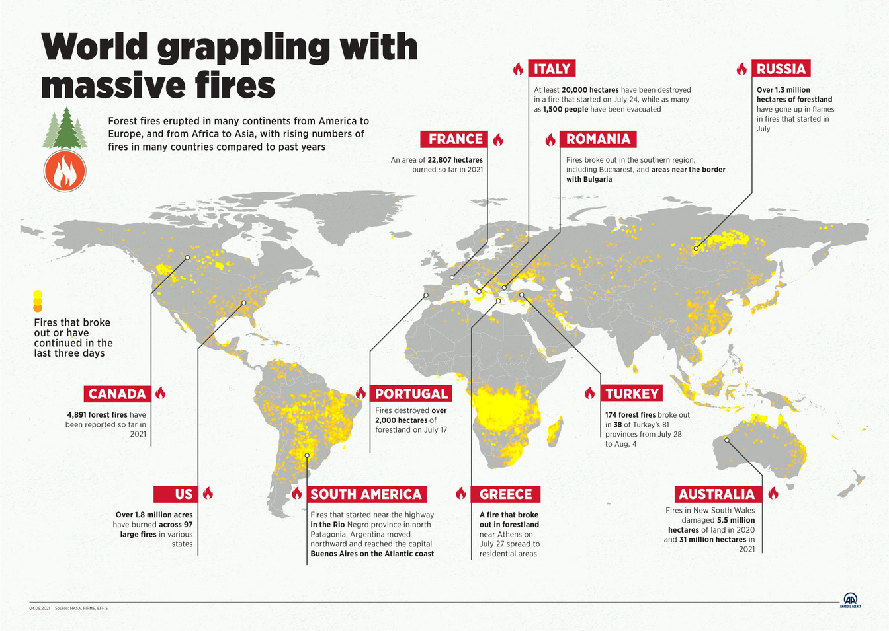
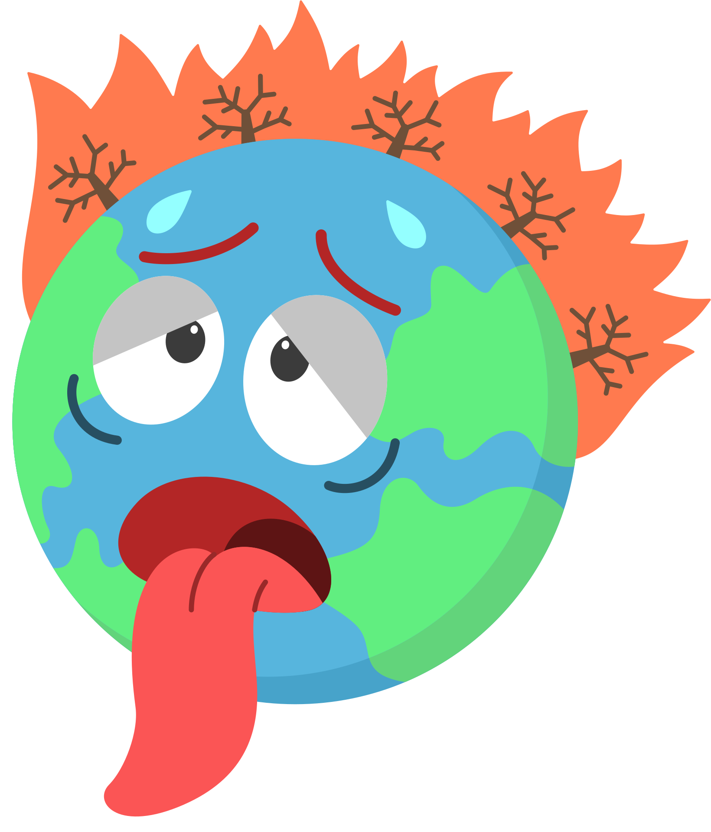
THE LARGEST WILDFIRES OF THE XXI CENTURY
PAGE
.06
Year | Country | Burned area [km^2]
2020-2021 | Australia | 338.000
2014 | Canada | 34.000
2019 | Russia | 43.000
2020 | USA | 18.000
2010 | Bolivia | 15.000
2019 | Brazil, Bolivia, Paraguay, Peru | 9.000
ENVIRONMENTAL CITIZENSHIP

Slide 8
CONSEQUENCES OF WILDFIRES
PAGE
.07
.01
disrupt transportation
.02
disrupt communications
.03
disrupt power and gas services, and water supply
.04
air pollution
.05
ENVIRONMENTAL CITIZENSHIP
threat to life and health
.06
.07
threat to animals
.08
material losses
.09
destruction of buildings
sterdestruction of forest ecosystem

Slide 9
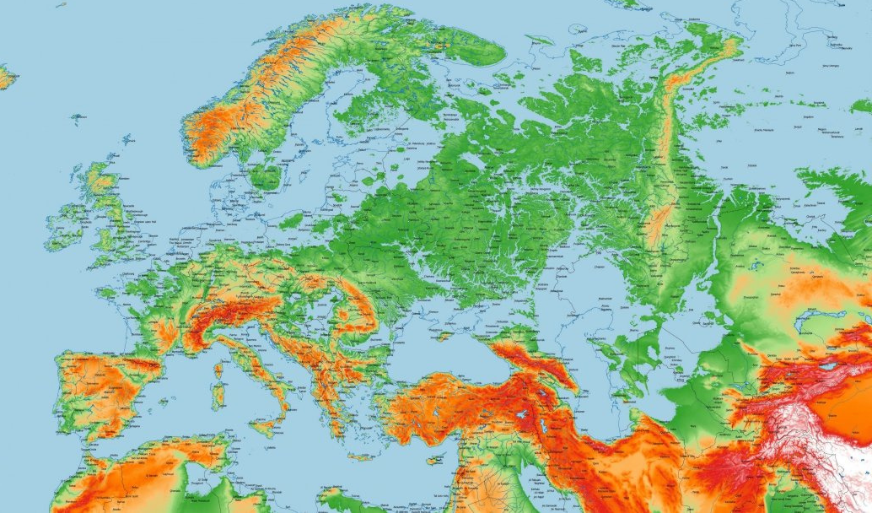
PAGE
SEA LEVEL RISE
.08
Seas and oceans cover about 71% of the earth's surface. Due to global warming, their level is raising. It is caused by several reasons:
thermal expansion
melting of glaciers
melting of ice sheets (Greenland and Antarctica)
human activity
ENVIRONMENTAL CITIZENSHIP

Slide 10
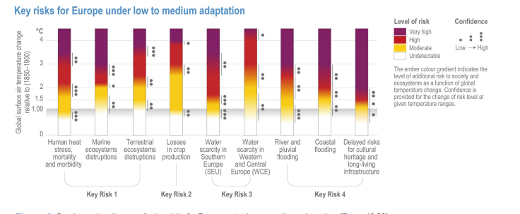
SEA LEVEL RISE - TERRIFYING FUTURE
PAGE
.09
According to IPCC report - risk is getting worse.
"Coastal flood damage is projected to increase at least tenfold by the end of the 21st century, and even more or earlier with current adaptation and mitigation (high confidence)."
ENVIRONMENTAL CITIZENSHIP

Slide 11
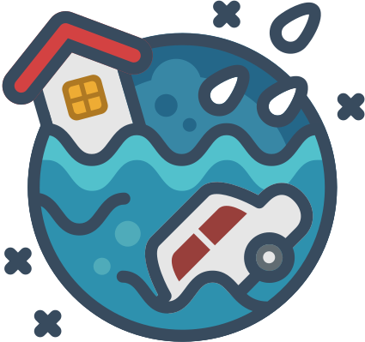
CONSEQUENCES OF SEA WATER RISING
PAGE
.10
.01
.02
.03
destructive erosion
wetland flooding
soil contamination with salt
.04
.05
contaminate drinking water
threat to human life and health
.06
lost habitat for fish, birds, and plants
.07
more dangerous hurricanes and typhoons
.08
ENVIRONMENTAL CITIZENSHIP
more powerful storms
.09
.10
forcing people to migrate to higher ground
.11
disappearance of large land areas
material losses

Slide 12
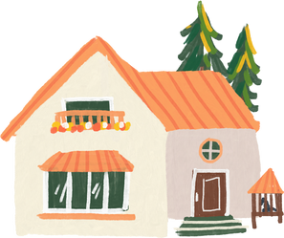
PAGE
WHAT RIGHTS ARE BEING VIOLATED BY CLIMAT CHANGE?
.11
.01
.02
.03
Right to Life and Personal Security
Right to Food
Right to Livelihood
drinking water,
natural resources,
property and shelter
.04
.05
.06
Right to Health
Minority rights
Right to Social Equality
ENVIRONMENTAL CITIZENSHIP

Slide 13
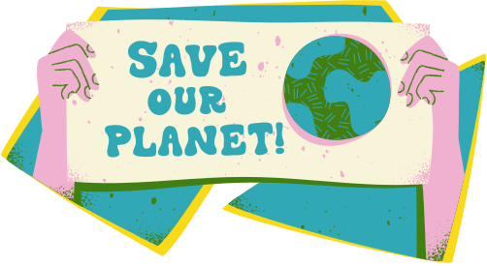
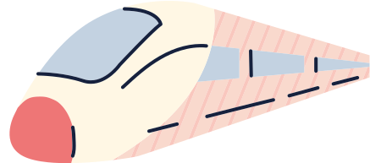
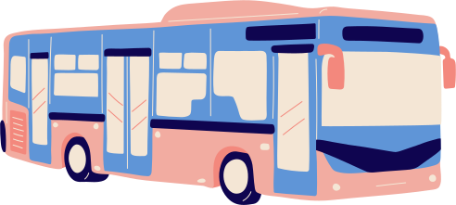
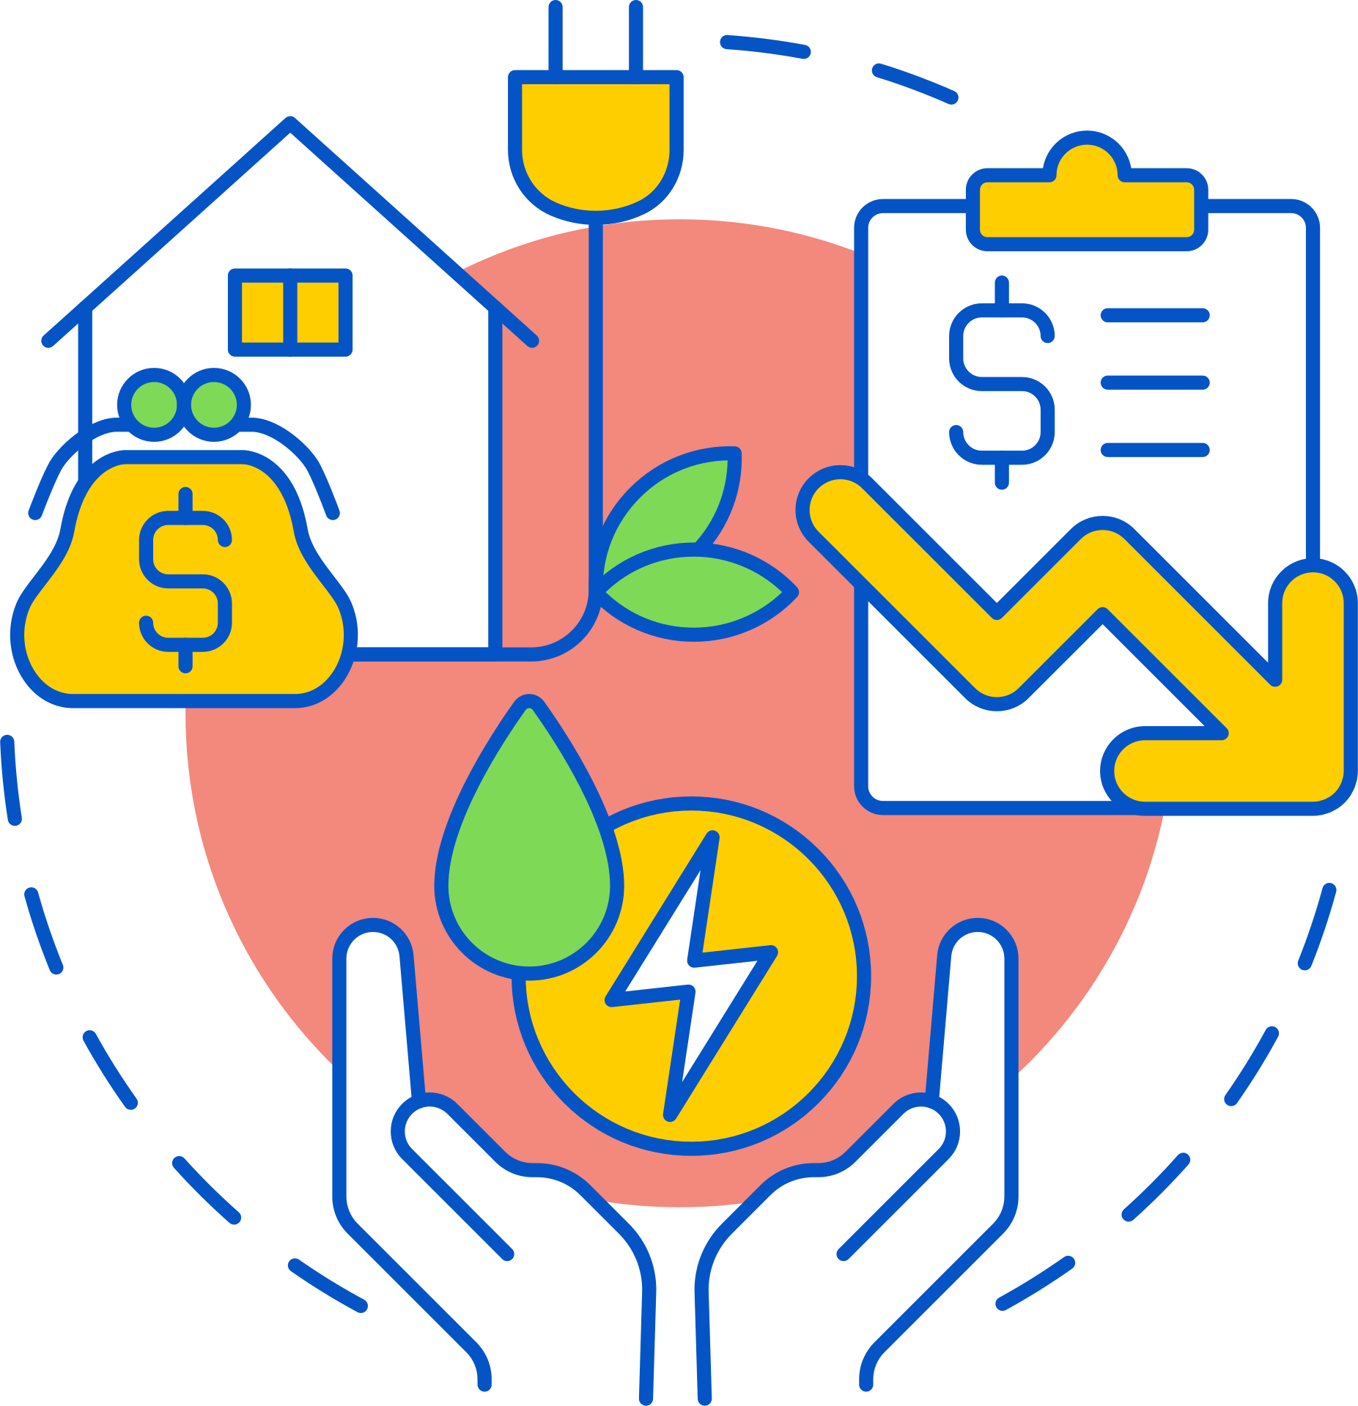
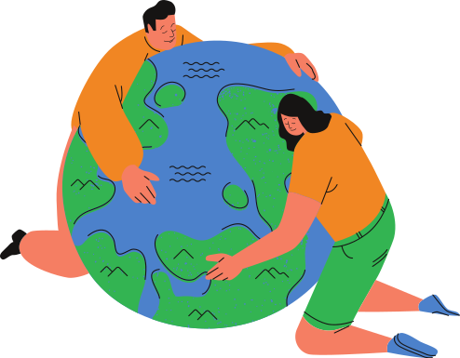
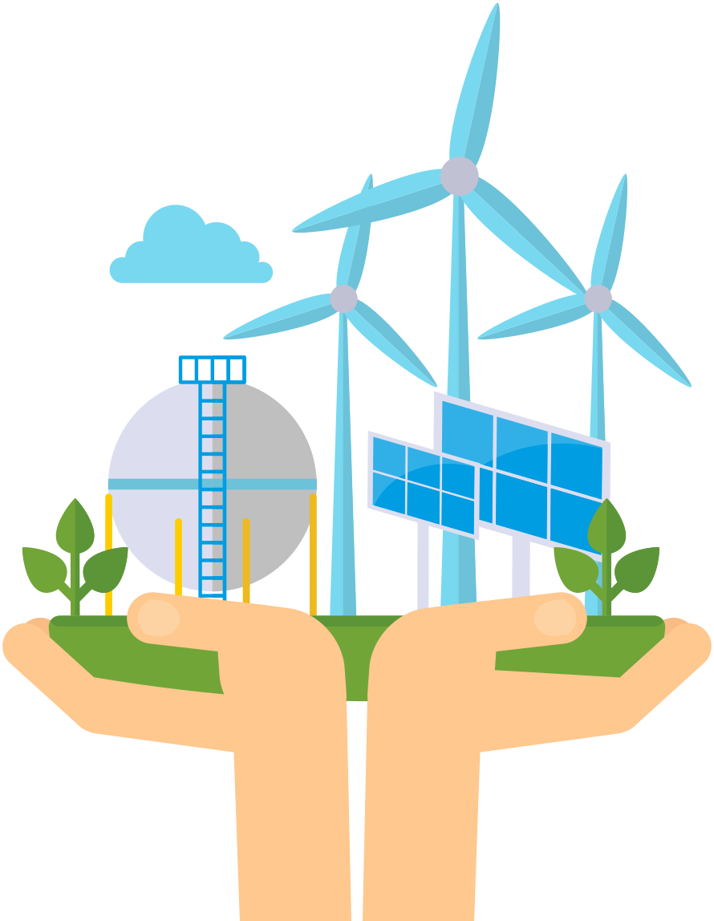
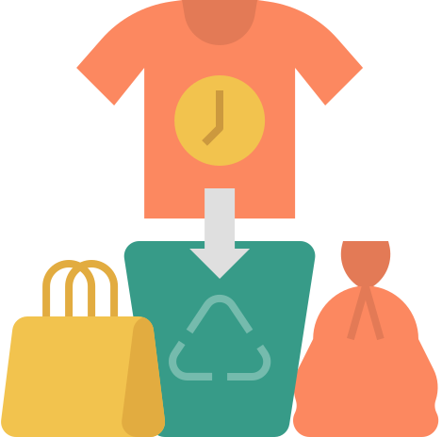
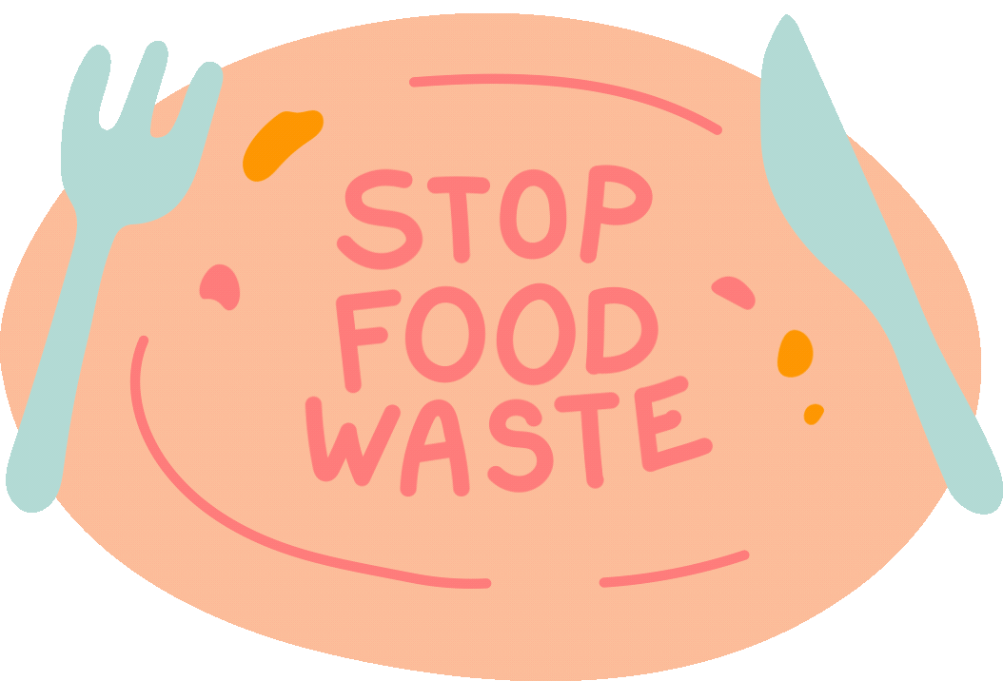
PAGE
Use public transport
.12
Reduce your energy use
Make your voice heard by those in power
WHAT CAN YOU DO TO IMPROVE THE CLIMATE?
Power your home with renewable energy
Don't buy things you don't necessarily need - that includes fast fashion
Respect and protect green spaces
ENVIRONMENTAL CITIZENSHIP
Use reusable items - reduce plastic consumption
Don't waste food and water

Slide 14
GOVERNMENTS' CURRENT AND FUTURE ACTIONS
PAGE
.13
Reducing U.S. greenhouse gas emissions 50-52% below 2005 levels by 2023,
Reaching 100% carbon pollution free.
Start phasing out coal mining in 2021 and close the last coal mine in 2049.
Poland could become climate-neutral by 2056.
By 2045, Sweden is going to have zero-net emission of greenhouse gasses.
By 2024 the number of wind turbines will reach to almost 6 000.
Greece is planning investments worth about 10 billion euros to expand its power grid by 2030, while it speeds up the development of renewable energy sources.
Australia's federal climate policies are based on its Technology Investment Roadmap, aimed at supporting technologies intended to help reduce carbon emissions by 2040.
ENVIRONMENTAL CITIZENSHIP
Turkey committed to be net-zero by 2053.

Slide 15
CURRENT GOALS AND ACTIONS - COMPANIES
PAGE
.14
In 2022:
Reducing the amount of plastic used in their cosmetics packaging up to 30% (10 tons a year).
Developing a network of refill stations with shower gel, soap, shampoo, even dishwashing liquid
Eco-routing, which displays a small leaf next to the Google Maps directions with the lowest carbon footprint.
Google is going to achieve a net-zero emissions target in 2030.
By the close of 2022, Netflx will achieve net zero greenhouse gas emission.
Netflix is also investing in external projects around the world that remove carbon from the atmosphere, such as protecting forests above-and-below water.
By 2030 Microsoft will be carbon negative, and by 2050 Microsoft will remove from the environment all the carbon the company has emitted either directly or by electrical consumption since it was founded in 1975.
Net zero emissions for direct operations by 2030.
100% zero carbon electricity by 2030.
Invest in natural climate solutions.
In 2021, InPost had over 300 electric vans. Every year there are more and more of them.
Delivery of a parcel to a parcel locker generates even 75% less carbon dioxide.

Slide 16
THANK
YOU
Dobrochna Figielek,
Julia Woźniak,
Marcin Kryjom,
Patryk Migaj.

